Slide 1
Abstractive Summarization
Presented By-Rittik Panda(MT2022090)

Slide 2
Problem Statement
Given a set of tweets pertaining to a trending topic, create an abstractive prose summary of the tweets. Do not just string the tweets together to form the summary. The summary will need to paraphrase and/or say more than what is directly said in the tweets. Propose a rubric to evaluate the accuracy of your summarization.

Slide 3
Proposed Evaluation Metrics
Rouge Score- ROGUE measures the similarity between the generated summary and the reference summary in terms of overlapping n-grams (contiguous sequences of n words) or word sequences.It calculates the percentage of overlapping n-grams (typically, 1-gram, 2-gram, or 3-gram) between the generated summary and the reference summaries.
Bert Score- BERT scores sentences based on their semantic similarity to the summary generated so far, their saliency or importance in the source text, or other relevant criteria. These scoring criteria can be determined based on the specific requirements of the summarization task and the design of the summarization model.
Comparison Between Rouge and Bert Score-1.The book is written by me 2.I am the author of that book . We can see that both the sentences carry same meaning.But Rouge score indicates low similarity
While Bert Score indicates high similarity:Precision = 0.9171 ,Recall=0.9120,F1- Score=0.9146
 | Rouge1 | Rouge2 | RougeL | RougeLsum
Rouge_Score | 0.3076 | 0.0 | 0.3076 | 0.3076

Slide 4
Work Done
Dataset Collection for Fine Tuning
Data Cleaning & Pre Processing
Summary Generation for our data points using chatgpt and classical NLP.
Finetuning various pretrained large language models using our custom dataset

Slide 5
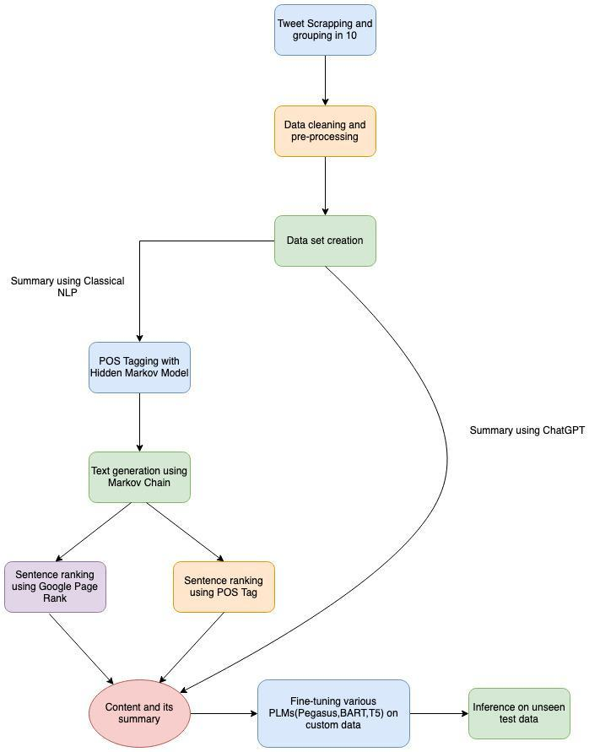
Full Projrct Overview

Slide 6
Dataset Collection for Fine Tuning:
Using ‘snscrape’ to scraped tweets on trending topics.At first,selected 10 trending topics and scraped 1000 tweets on each of the trending topics. After that,grouped 10 tweets in a single data point of our data set. So a tweet data set of 1000 data points got created.But there were no summaries with respect to the data points.

Slide 7
Data Cleaning & Pre Processing
After collecting the tweets the following data cleaning and pre processing steps were applied on them:
1.Lower casing
2.Traslating the tweets of various languages to English
3.Expansion of words
4.Removing URL
5.Removing RT & Emojis
6.Removing HTML tags
7.Removing Special Characters and Punctuation

Slide 8
● Summary Generation For Our Data Points:
After collecting the tweets and cleaning & pre processing them I took two approaches to create summaries for the data points in our data set.
1. Used OpenAI’s API to automate Chatgpt for generating summaries of our data points .
2. Also tried to explore various classical nlp approaches like - Text Ranking Using Google Page Rank algorithm, POS Tagging using Hidden Markov Models, Data generation using Markov chains to generate summaries for our datapoints.

Slide 9
Classical NLP Approach
At first given a preprocessed and clean datapoint (A group of sentences) I performed pos tagging on each of them using nltk’s pos_tag() function which uses a rule-based approach, which is based on a pre-trained set of hand-crafted rules to assign Part-of-Speech (POS) tags to words in a given text.
Then I made a list of important pos tags as per my knowledge important_pos_tags = ["NN", "NNS", "VB", "VBD", "VBG", "VBN", "VBP", "VBZ", "JJ", "JJR", "JJS"] And stored those words of our datapoint into a list whose pos tag matches any of our important pos tags.
Then I made a markov chain model for next word generation (got the transition probabilities of important words using our original datapoints) which randomly chooses important words from the list and generates next word based on transition probabilities.
Doing this I generated a group of new sentences from our original datapoint.
Finally I used google page rank algorithm to rank the newly generated sentences and took the top 50% sentences of my datapoint’s length as a summary of my datapoint. The TextRank algorithm is an unsupervised approach that uses graph-based methods to determine
. I observed the summaries generated using classical NLP approaches, even though they are syntactically and grammatically correct they are not always semantically meaningful.

Slide 10
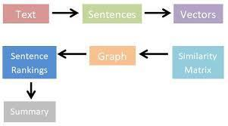
Text-Rank Algorithm

Slide 11
Finetuning various pretrained large language models using our custom dataset
Used various pretrained attention based seq2seq models from Huggingface’s Transformer Library namely Pegasus,T5,BART for abstractive text summarization on our custom dataset.
Results On Unseen Test Data:
Model | #Epochs | Rouge1 | Rouge2 | RougeL | RougeLSum | Bert Score
 |  |  |  |  |  | Precision | Recall | F1
Pretrained t5 |  | 0.2101 | 0.082602 | 0.1554 | 0.1555 | .83760 | .8339 | .8351
Finetuned t5 | 10 | 0.4195 | 0.2052 | 0.3173 | 0.3176 | .8887 | .8787 | 0.8835
Finetuned BART | 3 | .2609 | .1600 | .2323 | .2476 | 0.9151 | .8415 | .8765
Pretrained Pegasus |  | .3162 | .1548 | .2356 | .2348 | .8389 | .8437 | .8409
Finetuned Pegasus | 10 | .5089 | .2897 | .3844 | .3833 | .9415 | .9350 | .9381

Slide 12
References
1.https://towardsdatascience.com/basic-tweet-preprocessing-in-python- efd8360d529e 2.https://analyticsindiamag.com/guide-to-nlps-textrank-algorithm/ 3.https://www.kaggle.com/code/orion99/markov-chain-nlp/notebook 4.https://www.youtube.com/watch?v=00GKzGyWFEs&list=PLo2EIpI_JMQvWfQndUe su0nPBAtZ9gP1o

Slide 13
Thank You

